Slide 1
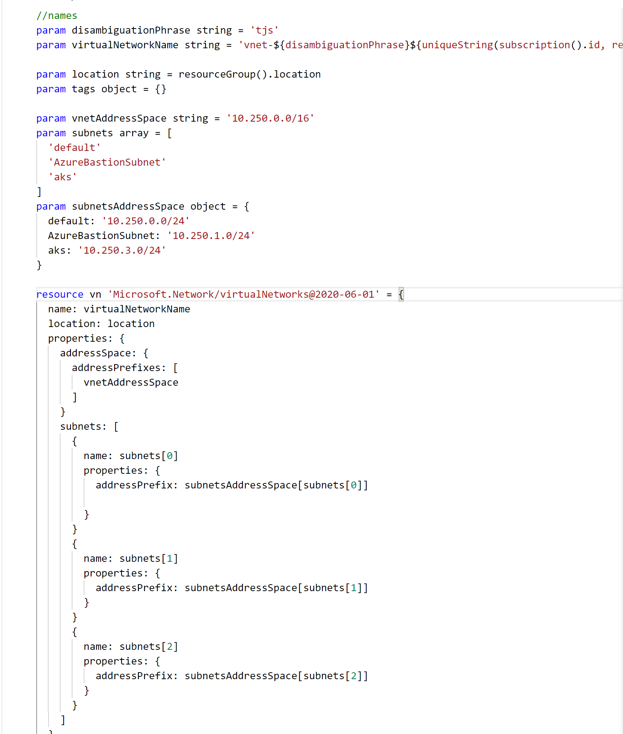



What The Hack
Infrastructure as Code
ARM Templates & DSC…
Host Name Here!
Job Title
email@yourcompany.com

Slide 2

What The Hack
Infrastructure as Code: ARM Templates
Welcome & Intros
Peter Laudati
Gino Filicetti
SME – Azure IaaS
SME – Azure IaaS
Al Wolchesky
Ali Hussain
SME – Azure IaaS
SME – Azure IaaS

Slide 3
Challenge #0 Get your machines ready!
Install Windows Subsystem for Linux (Bash Shell)
Install the Azure CLI (in WSL if on Windows!)
Install PowerShell Cmdlets for Azure
Install Visual Studio Code
Install ARM Tools plugin for VS Code
Install Azure Storage Explorer
Notes:
If you have a Mac… great! You’re already a step ahead.
If not, get your Windows box loaded up with all the tools that work well in the OSS world!

Slide 4
Infrastructure as Code

Slide 5
Infrastructure as Code
It’s critical to succeeding in the cloud!

Slide 6








Infrastructure as Code Three major parts
Deploying infrastructure
All of the stuff outside the VM
Vnets, VMs, load balancers, storage, etc
Configuration Management
Configuring all of the stuff inside the VM
Security, services, software, etc.
Orchestration
Stringing it all together with automation
ARM Templates
PowerShell
DSC
Notes:
If you have a Mac… great! You’re already a step ahead.
If not, get your Windows box loaded up with all the tools that work well in the OSS world!

Slide 7
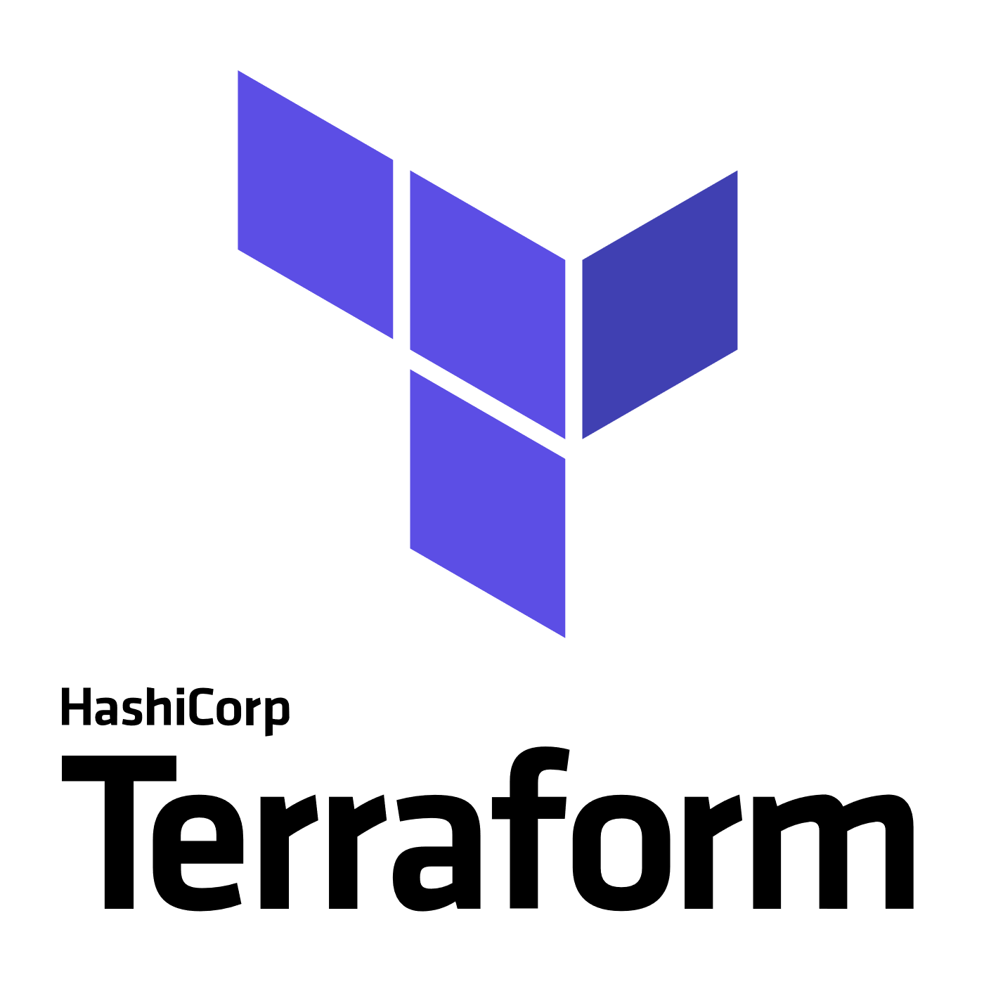
3rd Party
Infrastructure
Deployment (Orchestration)
Terraform
A popular Infrastructure as Code tool as it has support for Azure, AWS, GCP, OpenStack and bare metal, providing customers with a single provisioning language across providers
Provider modules allow for provider specific features, so no “lowest common denominator” flaws of similar multi-cloud tools
“Planning” provides users a preview of changes prior to execution (Terraform plan)
https://docs.microsoft.com/en-us/azure/virtual-machines/terraform-create-complete-vm
https://www.terraform.io/docs/providers/azurerm/
Packer
An automated image builder capable of building containers, but primarily used for automating VM image builds
A great tool when combined with DevOps pipelines that are targeting deployment to services like Azure VMs, VM Scale Sets or Batch
Used internally to deliver VM images for HD Insights and Azure Container Service
https://aka.ms/azpacker

Slide 8


3rd Party
Configuration Management & Orchestration
Ansible
Configuration Management & Orchestration
Agentless architecture over SSH / WinRM
Benefit of more easily integrating existing environments
YAML based “Playbooks” to define automation tasks as code
Project now run by Red Hat
https://docs.microsoft.com/en-us/azure/virtual-machines/linux/ansible-create-complete-vm
https://docs.ansible.com/ansible/guide_azure.html
Chef Server
Configuration Management
Integrates in to Chef’s Automate offering, available in Azure Marketplace
YAML/JSON based “Cookbooks” to define automation tasks as code
Agent based, requires an agent installed on managed servers.
https://www.chef.io/implementations/azure/
Notes:
Compare/Contrast: (Orchestration vs Configuration Management tools) Configuration management tools such as Chef and Ansible,typically default to a mutable infrastructure paradigm. For example, if you tell Chef to install a new version of OpenSSL, it’ll run the update on your existing servers and the changes will happen in-place. Over time, as you apply more and more updates, each server builds up a unique history of changes. This often can lead to configuration drift, where each server becomes slightly different than all the others, leading to subtle configuration bugs that are difficult to diagnose/reproduce. If you’re using an orchestration tool such as Terraform to deploy machine images created by Docker or Packer, then every “change” is actually a deployment of a new server, you would create a new image using Packer or Docker with the new version of OpenSSL already installed, deploy that image across a set of totally new servers, and then de-provision the old servers. This approach reduces the likelihood of configuration drift bugs. Of course, it’s possible to force configuration management tools to do immutable deployments too, but it’s not the idiomatic approach for those tools, whereas it’s a natural way to use orchestration tools.
Chef and Ansible encourage a procedural style where you write code that specifies, step-by-step, how to to achieve some desired end state. Terraform, CloudFormation, SaltStack, and Puppet all encourage a more declarative style where you write code that specifies your desired end state

Slide 9


OrchestrationTools
Jenkins
Most popular Continuous Integration & Continuous Delivery Tool
Especially popular with Java shops
An extensive community and catalog of plugins available
Azure Plugins available to use on-demand VMs for Build & Test
Jenkins Solution Template: https://aka.ms/jenkins-on-azure
Microsoft published. A Jenkins build secured for Azure and pre-configured with Azure plugins and tools
Jenkins Hub is a great starting point for customers: http://aka.ms/azjenkinshub
Spinnaker
Continuous Deployment Tool
Originally open sourced by NetFlix
Provides the ability to manage continuous deployment pipelines with multiple deployment strategies and the ability to roll back easily to previous versions
Spinnaker Code Labs for Azure:
CD to Azure VM ScaleSet
CD to K8s on Azure

Slide 10

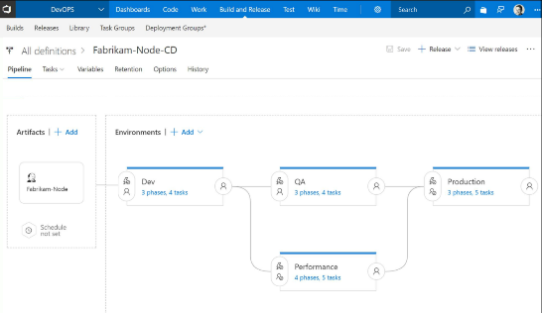
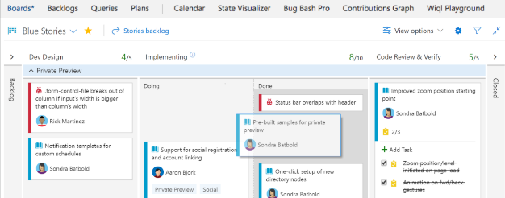
CI/CD Tools
Azure DevOps
Microsoft’s Continuous Integration & Continuous Delivery Tool
Test and deploy your code to production with high-performance pipelines. Start small and scale up as needed.
AzDO has everything you love about Git with free private repositories, pull requests, and code review.
Collaborate with coworkers then integrate with CI/CD to get your code to production fast.
AzDO gives you configurable Kanban boards, interactive backlogs, simple planning tools, and out-of-the-box support for Scrum-all integrated together for traceability and reporting.
Code once and share packages across your organization. Host your private Nuget, npm, and Maven packages with AzDO for more reliable, scalable builds.

Slide 11
Azure Resource Manager Overview

Slide 12



Azure structure
Account and enterprise agreement
Subscription(s)
Resource group
Resource group
SQL
SQL
Role-based access control
Tags
Azure Resource Manager policy
Templates
Notes:
Presentation notes:
Key concepts:
Resource groups: application lifecycle boundary; container that holds resources.
Resources: web apps, Azure SQL Database, storage account, network, and so on…almost everything.
RBAC (role-based access control): User groups with role permissions assigned to resource groups.
Tags: Key value pairs assigned to resources or resource groups.
Policy: Restrictions on resources; for example, we can enforce mandatory tags per resource type.
Templates: JSON (JavaScript Object Notation) defining deployment and configuration of your application.
Slide objective:
Explain the hierarchy of the Azure model and key concepts.
Speaker notes:
When we talk about how we’ve done our Azure structure, we think about subscriptions. You want to lay out your subscriptions based on technology, the type of policy that you want to apply, and how your business is laid out. We use RBAC, which is role-based access control, to ensure that the right people have the right access to the right subscriptions. We want to make sure that people can operate their business, information remains protected, and people can’t make changes when they’re not supposed to.
The lower level is the concept of the resource group, an Azure construct that allows you to put the various resources associated with a single app into a resource group and then apply policy from Azure Resource Manager and tags. We use tags—key-value pairs—in Microsoft IT to identify the organization that it’s related to, the environment, and the app ID, a unique identifier. We can use these tags to associate different resources to a different app, organization, or environment, and then make business decisions based on that. Resources include web apps, Azure SQL Database, storage account, and so on.
Templates: We’ve created specific templates that internal teams can use to build out resources, and we ensure that they build them out according to our standards and policies. Templates enforce the creation of tags for tracking.

Slide 13
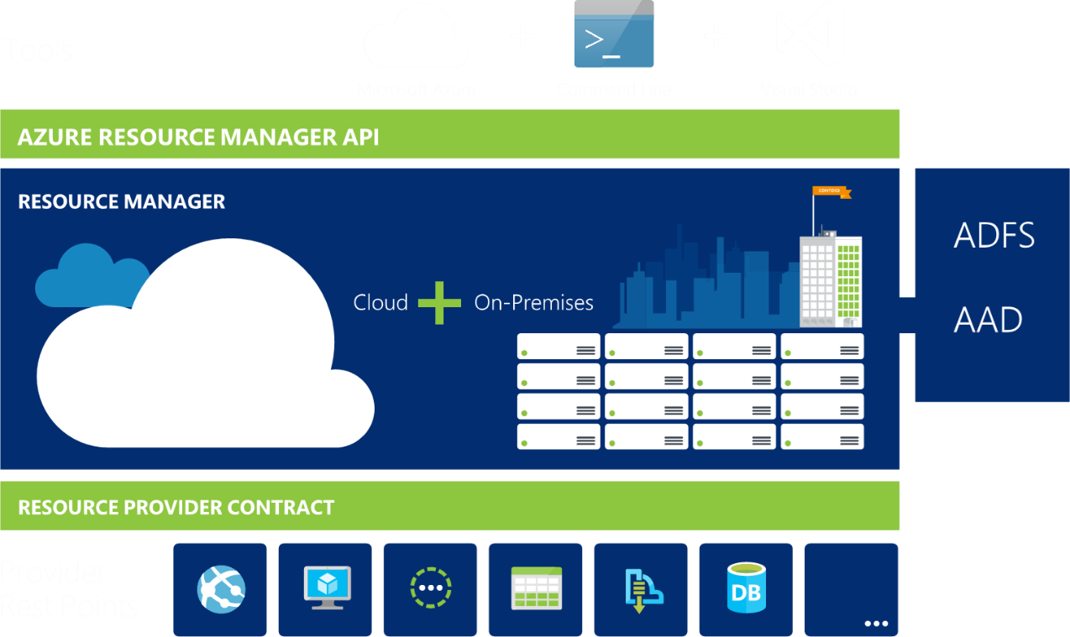
Azure Resource Manager
Azure Resource Manager or ARM management interface for Azure
Notes:
ARM is the underlying tooling that allows for the provisioning, securing and deployment of Azure Resources.

Slide 14
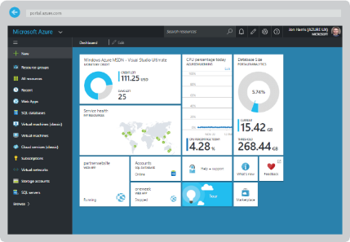
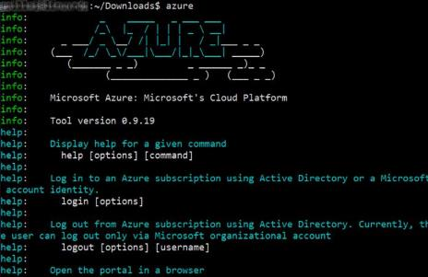
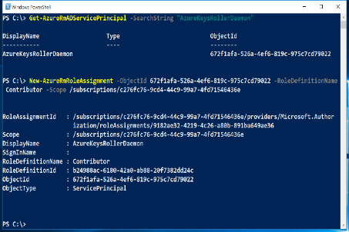

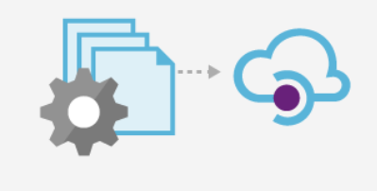
All interfaces lead to the same API…
Azure Portal
Azure CLI
Azure PowerShell
Azure Resource Manager
Azure API

Slide 15
Resource Providers
Web Site
Storage
Individual resources
Provision resources in isolation
Deployment becomes more complex
Management of app is challenging
Proper use of resources becomes more abstract
Isolation makes communication a challenge
Database
Virtual Machine

Slide 16
Resource Groups
Logical groups of multiple resources of similar or different types
Every resource must be in a resource group, cannot be in more than one
Resources inside resource group may span across regions
Resource Group has a location for storing metadata
RESOU
R
CE G
R
OUP

Slide 17
Resource Group Lifecycle
Question:
Should these resources be in the same group or a different one?
Hint:
Do they have common lifecycle and management?
Answer:
Up to you.

Slide 18
Organizational concepts
Resource groups
Tightly coupled to a container of resources
Follows RBAC rules
1 resource group at a time
Tags
Loosely coupled user or system defined categorization
Arbitrary boundaries
15 tags to use as needed
Resource groups and tags are the building blocks from which users define applications.

Slide 19
Access Control: RBAC
Allows secure access with granular permissions to resources
Assignable to users, groups or service principals or VMs
Built-in roles make it easy to get started

Slide 20
Azure Resource Manager Terminology
resource - A manageable item that is available through Azure (e.g. virtual machine, storage account, web app, database, virtual network etc)
resource group - A container that holds related resources for an Azure solution. The resource group can include all the resources for the solution, or only those resources that you want to manage as a group.
resource provider - A service that supplies the resources you can deploy and manage through Resource Manager. Each resource provider offers operations for working with the resources that are deployed. For example Microsoft.Compute is a provider that supplies the virtual machine resource.
Resource Manager template - A JavaScript Object Notation (JSON) file that defines one or more resources to deploy to a resource group. It also defines the dependencies between the deployed resources. The template can be used to deploy the resources consistently and repeatedly.
declarative syntax - Syntax that lets you state "Here is what I intend to create" without having to write the sequence of programming commands to create it. The Resource Manager template is an example of declarative syntax.

Slide 21
Scripting vs Declarative
PowerShell or Azure CLI
Sequential code calling commands to create the infrastructure.
ARM Templates
Either a Bicep domain-specific language (DSL) file or JavaScript Object Notation (JSON) file that defines one or more resources to deploy to a resource group. It also defines the dependencies between the deployed resources. The template can be used to deploy the resources consistently and repeatedly.
declarative syntax - Syntax that lets you state "Here is what I intend to create" without having to write the sequence of programming commands to create it. The ARM template is an example of declarative syntax.

Slide 22
Let’s get a look at a template…

Slide 23
The template
Structure and elements
{
"$schema": "http://schema.management.azure.com/schemas/2015-01-01/deploymentTemplate.json#",
"contentVersion": "",
"parameters": { },
"variables": { },
"resources": [ ],
"outputs": { }
}
Declarative syntax
Allows you to declare the resources you want to have without having to write the script sequence of commands required to create it.

Slide 24
The template - Parameters
Minimize parameters
Too many parameters may confuse the user
Use the “metadata” to describe the parameter
This can help the user identify how and where the value will be used
Define default values
Setting default values guides user and reduces chances of invalid values
Parameters are mandatory, use default value to “make it optional”
Use securestring type
Passwords and secrets should use the securestring type

Slide 25
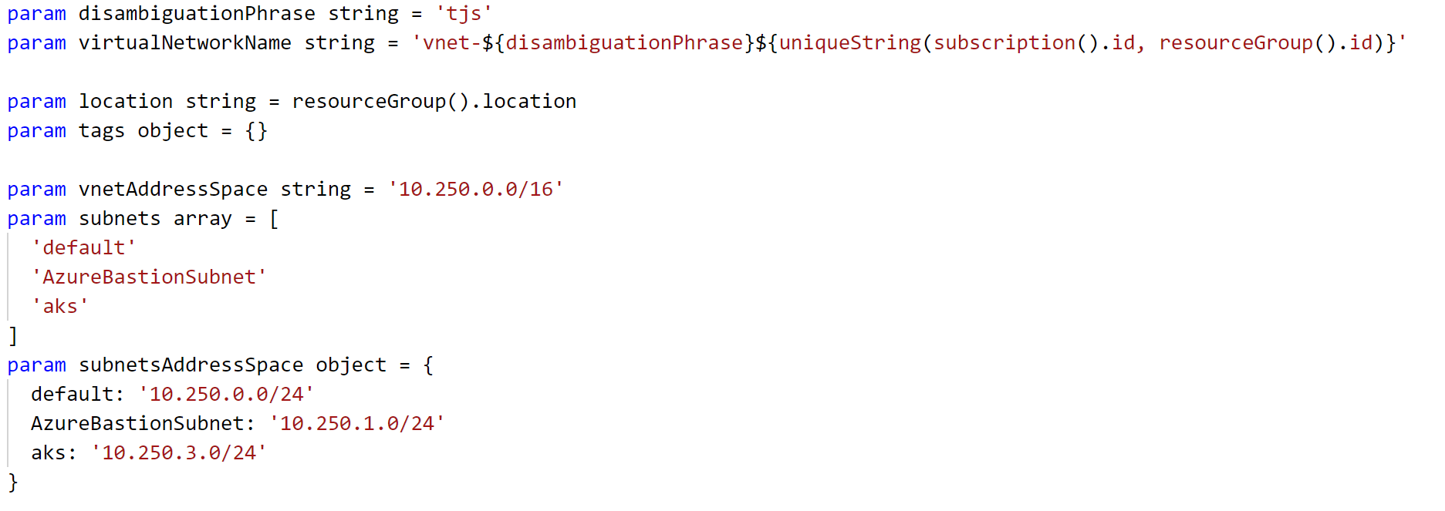
The template - Parameters

Slide 26
The template - Variables
Easier to read and edit
It can simplify your template, making it easier to read
Complex objects
Group variables into an object helps understand the template design
Custom values
Use expressions and functions to modify parameter values and construct new values

Slide 27
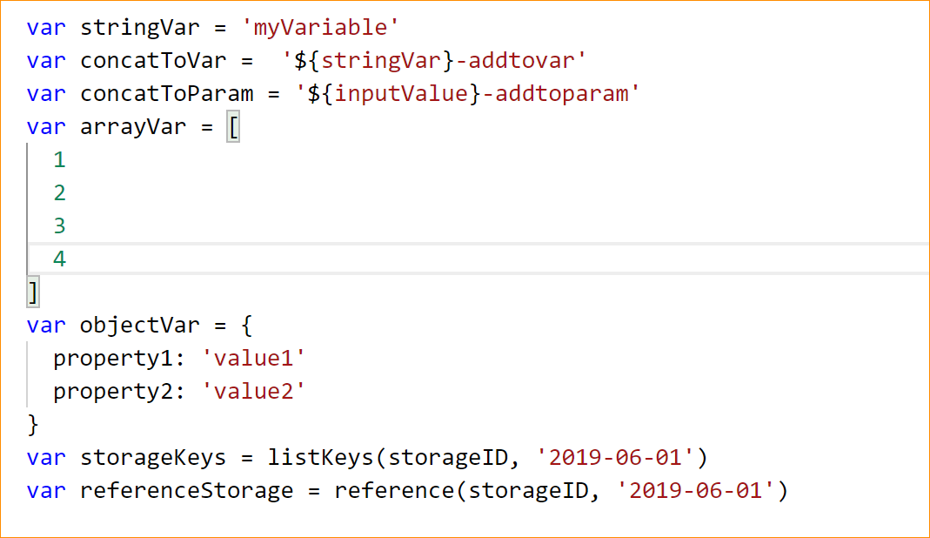
The template - Variables

Slide 28
The template - Resources
Use “comments”
Use this tag to help others understand the purpose of the resource
ApiVersion
This property value will define the structure of the “properties” section of the resource
Hard-code it on the resource, so Visual Studio Intellisense can recognize it
Protected Settings
Use this property to pass secrets if the resource type supports it

Slide 29
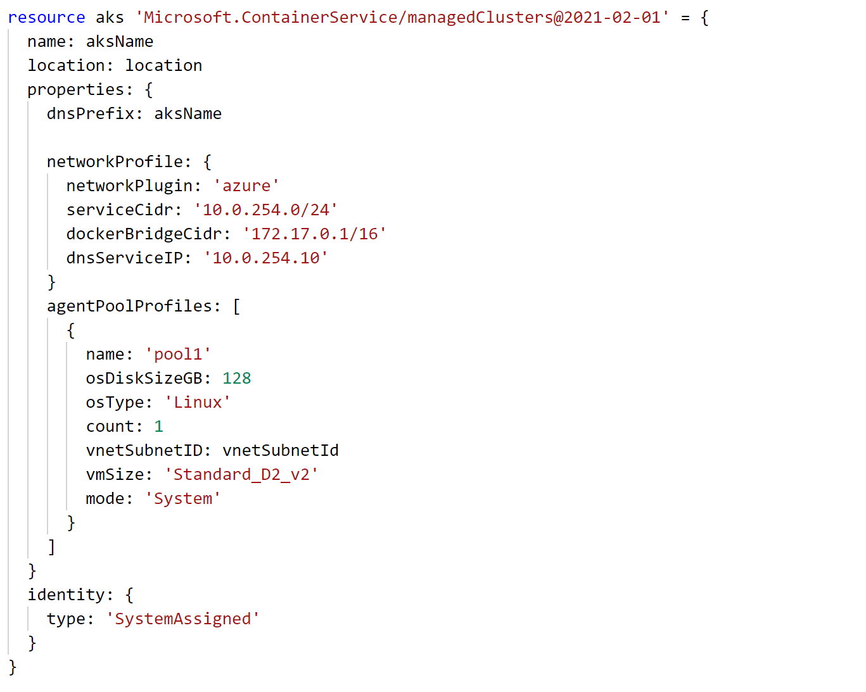
The template - Resources

Slide 30
Deploying the template
Powershell
New-AzureRmResourceGroupDeployment -Name ExampleDeployment -ResourceGroupName ExampleResourceGroup -TemplateFile <PathToTemplate> -
Azure CLI
azure group deployment create -f "c:\MyTemplates\example.json" -g examplegroup
-n exampledeployment
REST API
PUT /subscriptions/{subscriptionId}/resourcegroups/{resourceGroupName}/providers/Microsoft.Resources/deployments/{deploymentName}?api-version=2016-09-01
az deployment group create -f "c:\MyTemplates\example.bicep" -g examplegroup
-n exampledeployment

Slide 31
Template Tools ( http://aka.ms/azuretools )
Visual Studio
Visual Studio Code
PowerShell / CLI
VSTS
https://docs.microsoft.com/en-us/azure/azure-resource-manager/resource-group-template-functions
https://docs.microsoft.com/en-us/azure/templates/

Slide 32
Challenge #1 Create a “Hello World” template
Create a template that:
Takes one input parameter
Returns one output value
Deploy it from Azure CLI
Deploy it from PowerShell

Slide 33
ARM Templates Recap
Create a blank template with your favorite text editor
Complete walk-through : https://docs.microsoft.com/en-us/azure/azure-resource-manager/resource-group-authoring-templates
{
"$schema": "http://schema.management.azure.com/schemas/2015-01-01/deploymentTemplate.json#",
"contentVersion": "",
"parameters": { },
"variables": { },
"resources": [ ],
"outputs": { }
}
Strip away the details and the template core is seen above

Slide 34
Debugging…
Code Editors
Resource Explorer
Deployment output
Resource Group Deployments
Activity Logs
VM Extension Logs

Slide 35
The template – Parameters (re-visited)

Slide 36
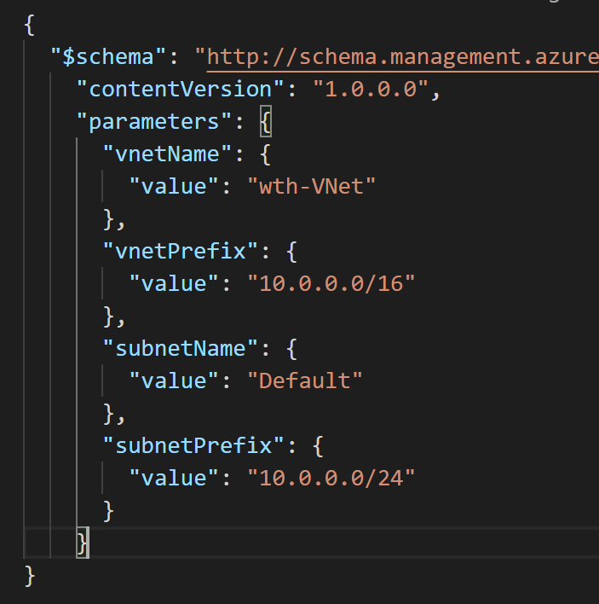
Parameter Files
Pass multiple values into a template at deployment time
Use different parameter files with the same template to support deployment to different environments (e.g. “dev/test”, “qa”, “production”)

Slide 37
Creating a template How to find template samples…
Visual Studio code
ARM Tools plugin can inject template syntax for various Azure resources
Go to the docs! https://docs.microsoft.com/en-us/azure/templates/
Export Template from portal before resource creation
Template will be parameterized for single resource
Quickstart templates
https://github.com/Azure/azure-quickstart-templates
Export Template from portal of existing Resource Group
To duplicate or slightly modify an existing template

Slide 38
Challenge #2 Deploy a simple network stack
Extend template to provision VNET w/one subnet
Template takes the following inputs:
Virtual Network Name and Address Prefix
Subnet Name and Address Prefix
Find an easier way to pass in parameters

Slide 39
ARM Template Functions
resourceGroup().location
concat()
resourceId()
Many more to explore later…

Slide 40
ARM Template Function: resourceGroup()

Slide 41
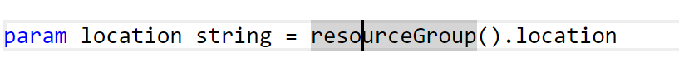
Snippet: resourceGroup() in action
All resources must be deployed to a location
Function provides the location of the resource group
Resources in a resource group can span multiple locations
E.g. A primary DB server located in “eastus” (same as the resource group), and secondary DB server located in “westus”

Slide 42
ARM Template Function: concat()

Slide 43
concat()…array and object function
Combines multiple arrays and returns the concatenated array, or combines multiple string values and returns the concatenated string
Concatenating multiple strings to create unique and dynamic names (in my opinion) is the most common and useful
“variables”: {
“vnetName”: “[concat(parameters(‘prefix’),’-VNET’)]”
…
}
https://docs.microsoft.com/en-us/azure/azure-resource-manager/resource-group-template-functions-array#concat

Slide 44
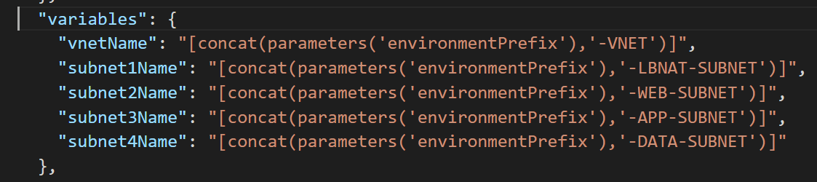
Snippet: concat() in action

Slide 45
ARM Template Function: resourceId()

Slide 46
ResourceID property
Unique identifier of a resource in Azure
Used to reference one resource as a parameter in another resource.
Example: A virtual machine needs to specify the resourceID of the NIC that it is attached to
Example: A NIC needs to specify the resourceID of the vnet+subnet that it is attached to. (Often, the Vnet will be deployed in a separate resource group!)
Example: A Vnet can specify the resourceID of a NSG that is applied to it.
A fully qualified ResourceID is a concatenation of:
<subscriptionID>/<resourceGroupName>/<resourceType>/<resourceName>
Example: “acc9711d-c67e-47b0-bba3-9f6561a68511/myResourceGroup/Microsoft.Network/networkSecurityGroups/myNSG”
ResourceID can be inferred from name & type if it’s unique within scope
Example: “<resourceType>/<resourceName>”
“Microsoft.Network/networkSecurityGroups/myNSG”
This works as long as there’s a NSG called “myNSG” in the current resource group.
If I’m looking for “myNSG” in some other resource group or subscription, then this won’t work!

Slide 47
resourceId()… The Resource Function
resourceId() is seen often in auto generated templates and some from the Git repo
Returns the unique identifier of a resource which is useful when the resource name is ambiguous or not provisioned with the same template
Often used to reference storage accounts or virtual networks in an alternate resource group
https://docs.microsoft.com/en-us/azure/azure-resource-manager/resource-group-template-functions-resource

Slide 48
Challenge #3 Deploy more than one resource
Extend template to open ports 80 and 22 on the default subnet
Hint: Consider variables, dependencies, resourceIds, and idempotency

Slide 49
Handling Secrets with Azure Key Vault AKA: Don’t Get Fired!
Do NOT store secret values in plain text JSON templates or parameter files
Seriously, this could cost you your job!
DO store secret values in Azure Key Vault
ARM templates provide an easy syntax for retrieving secret values from Azure Key Vault

Slide 50
Challenge #4 Let’s stay employed…
Create an Azure Key Vault and store a secret value in it
We have provided both Azure CLI & PowerShell Cmdlet scripts that do this for you.
You can find the scripts in the Resources folder for ARM-Challenge-04
create-key-vault-CLI.sh - Azure CLI
create-key-vault-PS.ps1 - PowerShell
Retrieve the secret value from Azure Key Vault and pass it into your template as a parameter without having the value exposed as plain text at any point in time!

Slide 51
ARM Template More Functions…
String
toLower()
uniqueString(context), talks about context of uniqueness (resourceGroup, Subscription, etc)
https://docs.microsoft.com/en-us/azure/azure-resource-manager/resource-group-template-functions-array

Slide 52
ARM Template Function: toLower()

Slide 53
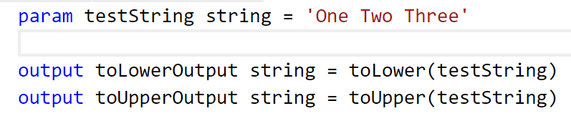
toLower()…string function
Useful collection string manipulation functions
How useful depends on your needs and approach to ARM templates
toLower() useful to help ensure proper formatting
Bicep functions - string - Azure Resource Manager | Microsoft Docs

Slide 54
Error without toLower()
Run nb-tolower-deploy.json with and without toLower (example error message without toLower below)
"error": {
"code": "AccountNameInvalid",
"message": "storev22NBTL062017 is not a valid storage account name. Storage account name must be between 3 and 24 characters in length and use numbers and lower-case letters only."
}

Slide 55
Advanced Functions: Food for thought
Some functions are easy to integrate into your templates (concat)
Some functions require some trial-and-error to get them to do what you expect (copyIndex)
Obviously, some functions are more useful than others and some are simply not worth the effort
The real question is…how much intelligence do you want to insert into your templates?
It might make more sense to use Powershell or CLI as the “glue” that holds the template(s) together and contains the “real” intelligence
The bigger the template, the harder to maintain

Slide 56
Practices to avoid. . . ( !best practices )
Starting from scratch. . .
Leverage QuickStarts, Automation Script / Export, etc. to quickly get started
Over-parameterization (no defaultValues)
Use variables, functions/expressions, & intelligent defaults!
Duplicating code
Copy/Pasting and Nesting instead of using copy loops & functions/expressions
Variables for the sake of variables
“vmName” : “[parameters(‘vmName’)]”
Secrets in source
Use KeyVault and Managed Identity
Variables for api-version
New api-version represents an updated payload
Using the wrong template expression, wrong function or wrong approach (mul)
E.g. use resourceId() instead of concat()
Not using a template expression or wrong function
Unnecessary dependencies
Use dependsOn and/or reference() only when necessary
Hard-coding
URIs, Ips, secrets, locations, VM sizes, etc
RunOnce behaviors
Build idempotent, re-entrant templates
Thinking imperatively
ARM templates describe the goal state of an application, and the sequence in which that state can be realized
https://github.com/Azure/azure-quickstart-templates
Notes:
NSG – Secure the app
User Choice – when it makes sense (location, SKU)
Use reference for endpoints

Slide 57
Challenge #5 (Windows) Let’s do something real…
Extend template to deploy a Virtual Machine
VM Requirements:
Windows Server 2016 Datacenter
Public IP address (for dev/hack purposes only. Never in production! ☺)
Clean up parameters and variables - use resource prefix & variable name suffixes
Hint: Globally unique naming context, and complex dependencies ☺

Slide 58
Challenge #5 (Linux) Let’s do something real…
Extend template to deploy a Virtual Machine
VM Requirements:
Ubuntu 18.04 LTS
Public IP address (for dev/hack purposes only. Never in production! ☺)
Clean up parameters and variables - use resource prefix & variable name suffixes
Hint: Globally unique naming context, and complex dependencies. ☺

Slide 59
ARM Templates: configuration management via custom script extension

Slide 60
Challenge #6 Configure the VM
Extend template to configure the VM as a webserver
VM Requirements:
Linux VM (Ubuntu)
Apache website
Pull website config from: https://raw.githubusercontent.com/microsoft/WhatTheHack/master/011-InfraAsCode-ARM-DSC/Student/Resources/ARM-Challenge-04/create-key-vault-CLI.sh
Hint: Custom script extensions, globally unique naming context, and complex dependencies. ☺

Slide 61
ARM Templates: Implementing high availability

Slide 62
High Availability What does that mean?
Availability within a single Azure region
Expectation is little or no downtime (99.x % uptime)
IaaS – Customer responsibility
PaaS – Azure responsibility

Slide 63
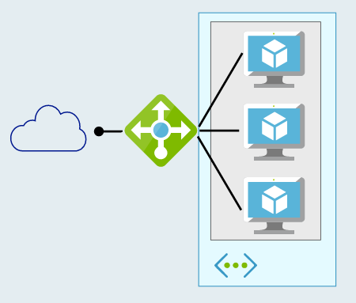
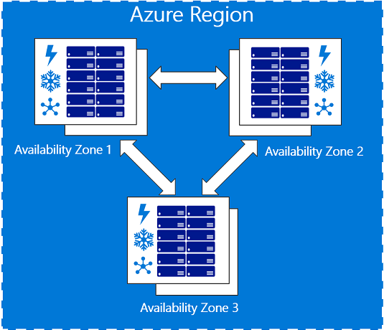
High Availability How do you implement it?
Availability Sets – 99.95% SLA
2 or more VMs in an Availability Set configured behind a Load Balancer
Availability Zones – 99.99% SLA
2 or more VMs spread across Availability Zones configured behind a Standard Load Balancer

Slide 64
ARM Template Function: copyIndex() aka looping

Slide 65
copyIndex()… Numeric Function
Add a “copy” section to a resource and reference with the copyIndex() function
"resources": [
{
"apiVersion": "2016-01-01",
"type": "Microsoft.Storage/storageAccounts",
"name": "[concat(copyIndex(),'storage', uniqueString(resourceGroup().id))]",
"location": "[resourceGroup().location]",
"sku": {
"name": "Standard_LRS"
},
"kind": "Storage",
"properties": {},
"copy": {
"name": "storagecopy",
"count": 3
}
}
https://docs.microsoft.com/en-us/azure/azure-resource-manager/resource-group-create-multiple

Slide 66
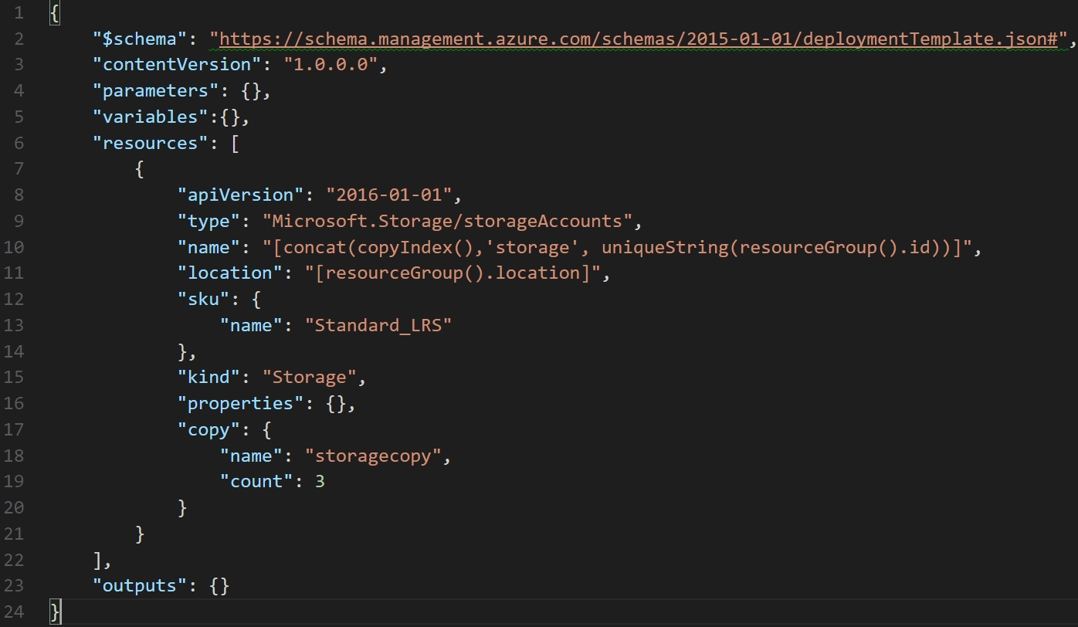

Slide 67
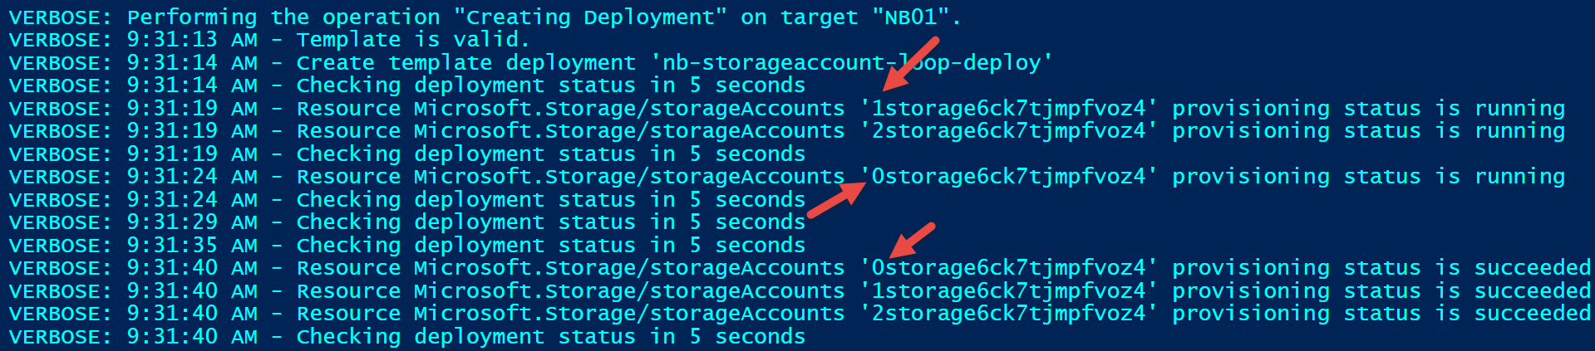
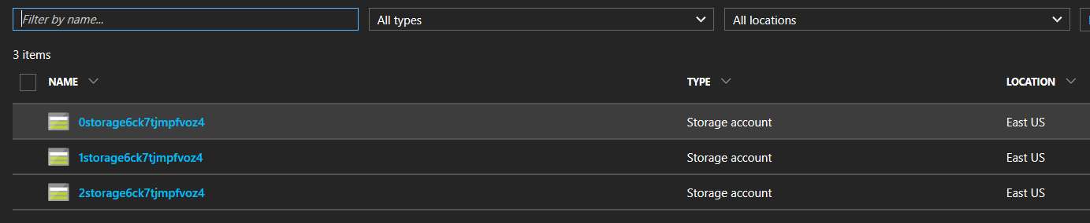
Verbose output

Slide 68
Can I create more meaningful names?
Tried:
"name": "[concat('storage-0', copyIndex(1))]", (did it work?)
Got error:
New-AzureRmResourceGroupDeployment : 9:51:45 AM - Error: Code=AccountNameInvalid; Message=storage-01 is not a valid storage account name. Storage account name must be between 3 and 24 characters in length and use numbers and lower-case letters only.
Tried:
"name": "[concat('storage0', copyIndex(1))]", (did it work?)
Got error:
New-AzureRmResourceGroupDeployment : 9:52:45 AM - Error: Code=StorageAccountAlreadyTaken; Message=The storage account named storage01 is already taken.

Slide 69
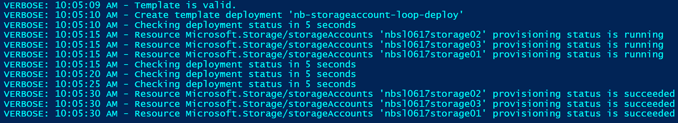
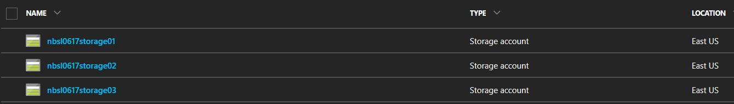
Got it working…finally
Tried:
"name": "[concat(parameters('environmentPrefix'),'storage0', copyIndex(1))]"

Slide 70
Final notes on looping with copyIndex()
You can iteratively create multiple resources of the same type
Resources are created in parallel unless the mode is set to “serial” (default is parallel…should it specified?)
You can iterate on a resource property also

Slide 71
Challenge #7 Make it highly available!
Extend ARM template to:
Add a second webserver VM
Add a public Load Balancer
Put the webservers in a backend pool
Create frontend pool enabling port 80 to website
Ensure the VMs are highly available!

Slide 72
ARM Templates: Configuring a Load Balancer

Slide 73
Challenge #9 Let in the SSH in
Extend your ARM template to configure the Load Balancer to enable SSH access to the backend virtual machines

Slide 74
ARM Templates: VM Scale Sets – a better way!

Slide 75
Challenge #10 A better way to HA
Modify the ARM template to replace the existing two virtual machines with a VM Scale Set
Configure the VMSS to have two instances
Ensure the load balancer is configured to allow you to SSH to the VMs in the scale set.

Slide 76
ARM Templates: Configuration management via custom script extension

Slide 77
Challenge #11 Configure the VM
Extend template to configure the VMs in the scale set as webservers
VM Requirements:
Linux VM (Ubuntu)
Apache website
Pull website config from: https://raw.githubusercontent.com/microsoft/WhatTheHack/master/011-InfraAsCode-ARM-DSC/Student/Resources/ARM-Challenge-10/install_apache_vmss.sh
Hint: Custom script extensions, globally unique naming context, and complex dependencies. ☺

Slide 78
ARM Advanced Feature: Linked Templates

Slide 79
Linked/Nested Templates
Useful for “separation of duties” (e.g. network team responsible for network templates, etc)
Linked templates cannot be local.
Linked templates must be ‘staged’ at an http endpoint for the Azure Resource Manager to access them.
Use a storage account or git repo for staging
You can pass parameters directly to the linked template as you would the parent template
{
"type": "Microsoft.Resources/deployments",
…
}
https://docs.microsoft.com/en-us/azure/azure-resource-manager/resource-group-template-functions-deployment

Slide 80
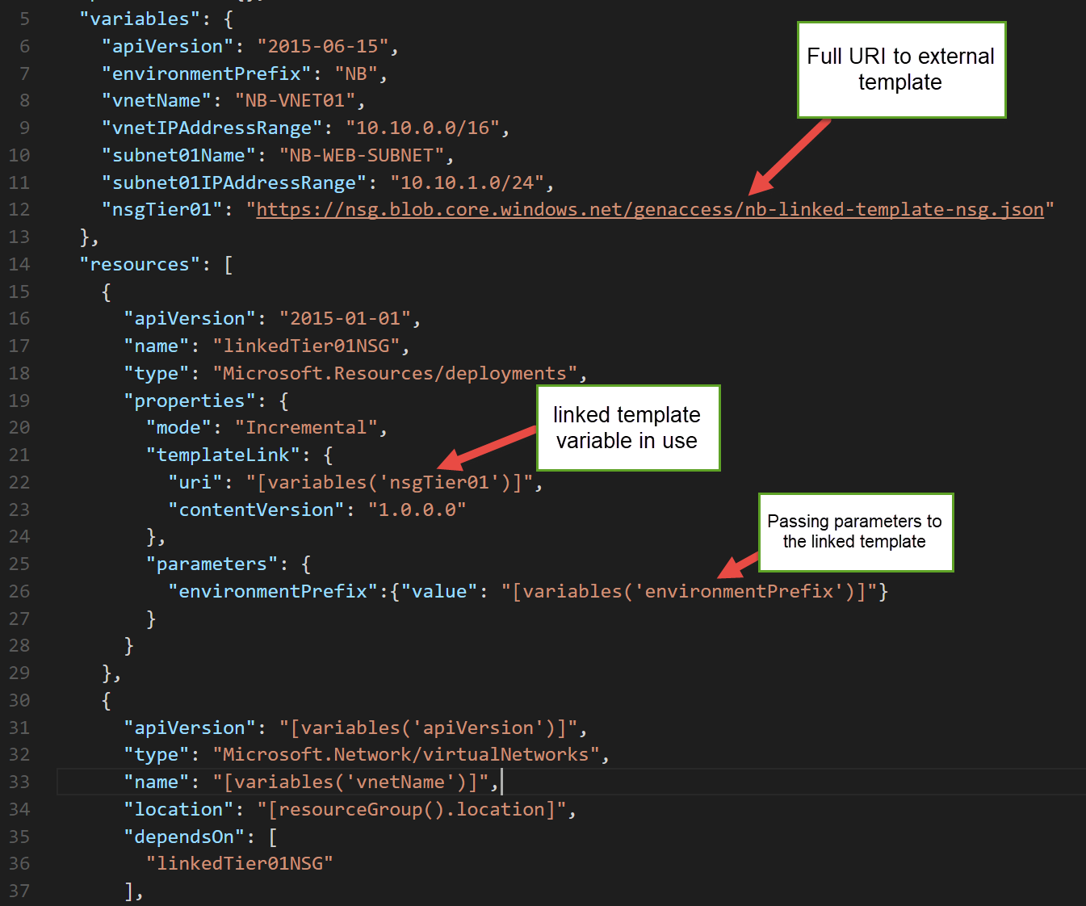
Example

Slide 81
What about linking to “private” templates?
We can do this with a SAS token!
Generate a SAS token on the container where your “private” template will be staged.
Pass the blob container URL & SAS token as parameters
Concatenate the container URL, template filename, and SAS token to construct the templateLink URI property
https://docs.microsoft.com/en-us/azure/azure-resource-manager/resource-group-linked-templates
https://docs.microsoft.com/en-us/azure/storage/storage-dotnet-shared-access-signature-part-1

Slide 82
Challenge #12 Break it up!
Pull out the VNet & NSG into their own template
Keep the VM (and its dependencies– NIC, PIP, etc) in its own template
Create a new “master” template that calls the Networking template, then the VM template

Slide 83
Desired State Configuration

Slide 84
Desired State Configuration (aka DSC) Demo here…
What is DSC?
How do you use it?
What are DSC Resources
Code snippet of DSC script

Slide 85
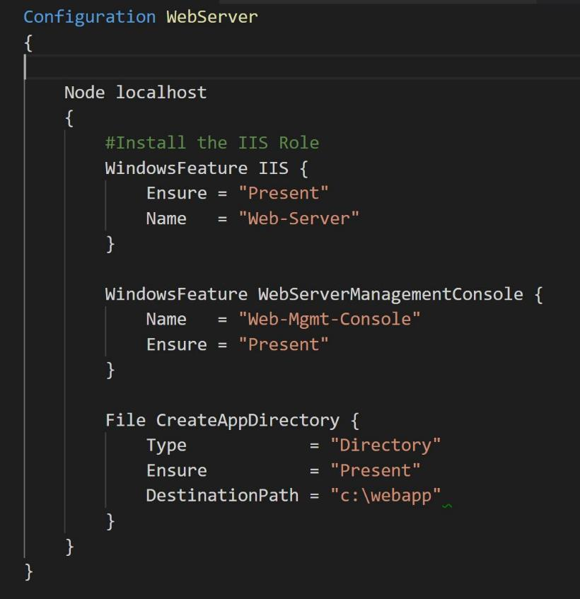
Desired State Configuration (aka DSC) Built in DSC Resources…
Archive Resource
Environment Resource
File Resource
Group Resource
Log Resource
Package Resource
Registry Resource
Script Resource
Service Resource
User Resource
WindowsFeature Resource
WindowsProcess Resource
Built in DSC Resources: https://docs.microsoft.com/en-us/powershell/dsc/builtinresource

Slide 86
Desired State Configuration (aka DSC) What goes where…
Package DSC script (script.ps1) into archive (script.ps1.zip)
Deploy archive file to staging (artifact location/blob storage)
Provide staging URI to ARM template’s DSC Extension resource

Slide 87
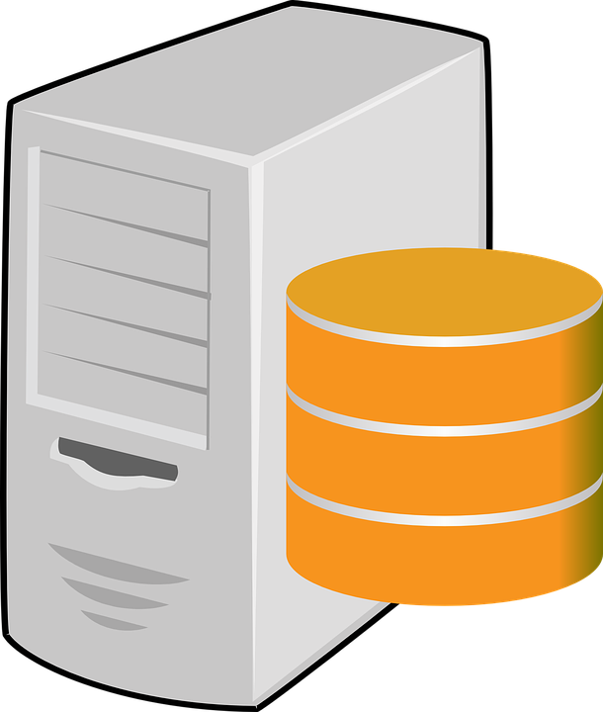
A File Server!!!

Slide 88
DSC Challenge #2 Hello World DSC
Add a DSC extension to the ARM Template
Add a DSC script to add 3 folders to the C drive
Ex: “Folder1”, “Folder2”, “Folder3”
Go through the motions of packaging the DSC script up and deploying via blob storage

Slide 89
Using DSC Resources How to fish for new ones…
Browse PowerShell Gallery
Browse PowerShell Github Repo
Browse Azure Quickstart Templates
Google it* with Bing! (*where ‘it’ is the task you want to configure with DSC)
Repeat!

Slide 90
Using DSC Resources Once you find the droid you’re looking for…
Read its docs & examples on its Github repo
Add a Import-Module –Name <DSCResourceName> statement
Use it in your DSC script! (.ps1 file)
Download/install the module locally on your workstation
Include the module’s files in the archive file
Deploy the archive file to the staging location
Hint: Use the Publish-AzureRmVMDscConfiguration cmdlet to package & stage the archive file directly to Blob Storage!

Slide 91
DSC Challenge #3 More complex DSC
Extend the DSC by creating SMB shares on each folder
Ex: \\Share1, \\Share2, \\Share3
Hint: Use a DSC Resource

Slide 92
Composite DSC Let’s refactor out some common code…
DSC configurations can get long and complex quickly.
You want to have custom DSC resources specifically for your infrastructure
Useful for splitting the management of desired state amongst different teams.

Slide 93
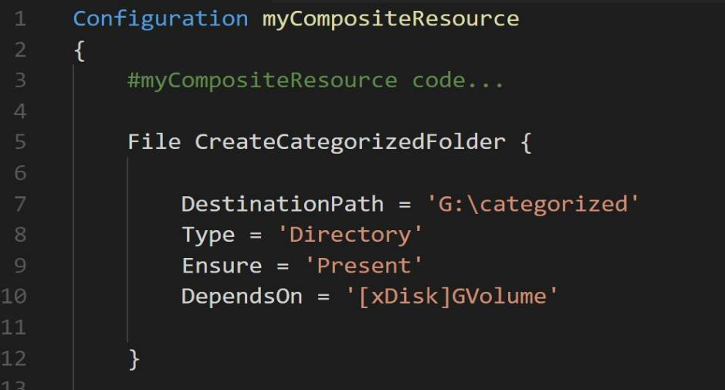
Composite DSC - Layout
<ParentFolder> → Add this folder to the PowerShell path for the publish tool to work
MyCompositeResourcePackage (Folder)
1.0 (Folder – version number)
MyCompositeResourcePackage.psd1 (<-manifest file. Auto generated by New-ModuleManifest tool)
DSCResources (Folder)
myCompositeResource (Folder)
myCompositeResource.psd1 (<-manifest file. Auto generated by New-ModuleManifest tool)
myCompositeResource.schema.psm1 (<- code file where your common code goes!)
The name of the PSD1 & PSM1 must be the same as the name of the Configuration block in your PSM1 file! ☺
No “node” block in the psm1 file!

Slide 94
Packaging Your Composite Resource
Publish-AzureRMVMDscConfiguration needs to know about your new Composite Resource
Change the path of Powershell to include your new local folder:
$env:PSModulePath = $env:PSModulePath + “;” + “myDscs;” (myDscs is the root containing your Composite Resource).
Now run your Publish command

Slide 95
DSC Challenge #4 Composite DSC
Break out the DSC that creates the folders into a composite DSC
Leave the DSC that creates the SMB shares.
Don’t forget your DependsOn section in the DSC
Find the directory structure
Create your Manifests: New-ModuleManifest –Path xxx
Package manually

Slide 96
Bonus DSC Challenges

Slide 97
Bonus DSC Challenge #1 Windows Web Server
Add a DSC extension to the ARM Template
Add a DSC script to enable IIS and turn off the default website
Go through the motions of packaging the DSC script up and deploying via blob storage

Slide 98
Bonus DSC Challenge #2 More complex DSC
Extend the DSC by creating a new website
Pull a ZIP file from blob storage
Unpack the zip file into a new site directory

Slide 99
Bonus DSC Challenge #3 Composite DSC
Break out the DSC that enables IIS and disables the default website into a composite DSC
Leave the custom web site things in the main DSC script

